Slide 1

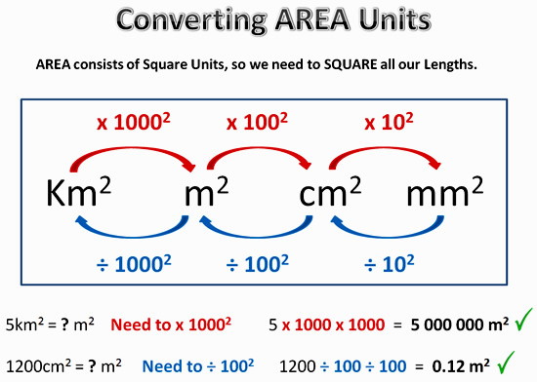
My Measurement Interactive Notebook
Name
Class
Teacher Mr Evans
Term 2 Semester 1
1

Slide 2
Contents
Glossary or Formula Page
Page
Date
Description
2
3

Slide 3
Tasks
24
7
30
Essential Question
Questions
Notes
Summary
6
7

Slide 4
24
7
30
Date
Converting Units of Length and Area
EQ – Describe how to convert units of length and area.
How do we convert units of length?
5

Slide 5
24
7
30
Date
Converting Units of Length and Area
EQ – Describe how to convert units of length and area.
How do we convert units of area?
5

Slide 6
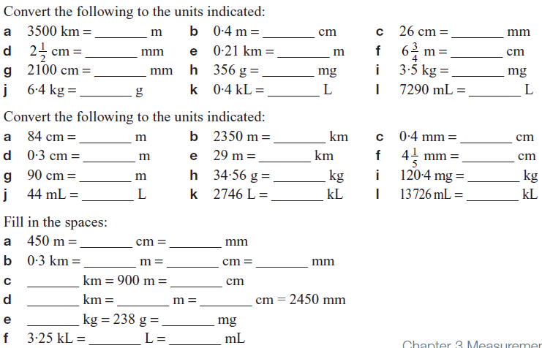
Questions

Slide 7
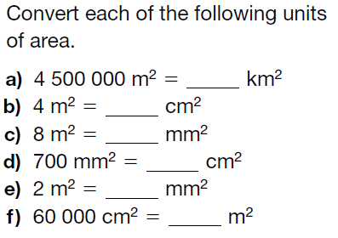
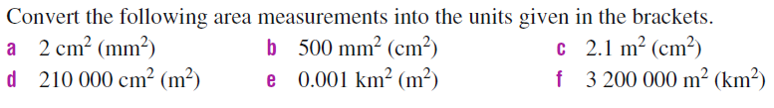
Questions

Slide 8
Answers

Slide 9
Notes Review
24, 7 ,30
Date
Title
Essential question
Notes complete
Notes complete with colour and diagrams
Questions completed
Contents page filed in
Formula page filled in

Slide 10
Homework
Review your notes and write a summary answering the essential question.

